Slide 1
Improving ML Training and Inference with Dynamic Hyperparameter Optimization
Angela Jiang
Thesis committee
Greg Ganger (Chair)
Dave Andersen
Michael Kaminsky
Michael Kozuch
Padmanabhan Pillai
Rahul Sukthankar

Slide 2
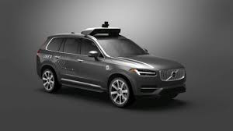
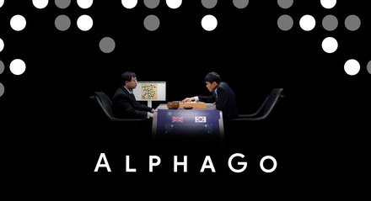

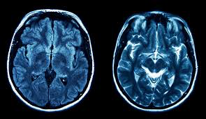
Introduction
DNNS EMPOWER EMERGING APPLICATIONS
Improve efficiency and robustness
of deep learning systems

Slide 3

Introduction
TRAINING AND DEPLOYING DNNS REQUIRE TUNING

Slide 4
Introduction
TRAINING AND DEPLOYING DNNS REQUIRE TUNING
Learning rate
Momentum
Dropout
Architecture
Optimizer
Training time
Parameters tuned
once and before training

Slide 5
Introduction
CONDITIONS CHANGE OVER TIME
Over course of training
Magnitude of gradients
Magnitude of losses
Training loss
Test loss
Training error
Test error
…
Over course of deployment
Deployment hardware
Deployment software
Deployed applications
Latency SLAs
Accuracy SLAs
…

Slide 6
Introduction
CONDITIONS CHANGE OVER TIME
Over course of training
Magnitude of gradients
Magnitude of losses
Training loss
Test loss
Training error
Test error
…
Over course of deployment
Deployment hardware
Deployment software
Deployed applications
Latency SLAs
Accuracy SLAs
…
NO SINGLE BEST VALUE

Slide 7
Introduction
LEARNING RATE IS ADAPTIVELY TUNED
Fixed learning rate
Manual learning rate decay
Optimizers
Adagrad
RMSProp
Adam
Notes:
Adagrad: We perform larger updates for infrequent parameters and smaller updates for frequent parameters.
RMSProp: Normalizes the gradient using the magnitude of the recent gradients

Slide 8
Introduction
THESIS STATEMENT
Using runtime information to dynamically adapt hyperparameters that are traditionally static, such as emphasis on individual training examples and the weights updated during transfer learning, can increase the accuracy and speed of ML training and inference.

Slide 9
Introduction
THESIS STATEMENT
Using runtime information to dynamically adapt hyperparameters that are traditionally static, such as emphasis on individual training examples and the weights updated during transfer learning, can increase the accuracy and speed of ML training and inference.

Slide 10
Introduction
THESIS STATEMENT
Using runtime information to dynamically adapt hyperparameters that are traditionally static, such as emphasis on individual training examples and the weights updated during transfer learning, can increase the accuracy and speed of ML training and inference.

Slide 11
Introduction
CASE STUDIES
SelectiveBackprop
Adaptive Sampling for DNN Training
Mainstream
Adaptive Stem-Sharing for DNN Inference

Slide 12
Introduction
CASE STUDIES
SelectiveBackprop
SB Adapting what examples we find challenging
AdaptSB Adapting what we do with challenging examples
Mainstream
Adaptive Stem-Sharing for DNN Inference

Slide 13
SelectiveBackprop
DNN TRAINING ANALYZES MANY EXAMPLES
Notes:
However, it’s hard to create these underlying DNNs. The way these models work, is you show them examples of what it's supposed to be predicting. For instance, if you want your DNN to be able to recognize pedastrians, you need to show it millions of examples of different pedestrians over and over and over again. You can imagine, that this takes a lot of time and computing resources.

Slide 14
SelectiveBackprop
DATASETS CAN BE TOO LARGE TO TRAIN ON EVERYTHING
ImageNet dataset: 15 million examples
OpenImages dataset: 9 million examples
Production datasets are often much larger
Google JFT dataset: 300 million examples
amazon click-through data
Uber autonomous vehicle training video
Notes:
In fact, these datasets are sometimes so large that we cannot train on all the data. This might be in contrast with what you’ve heard, which is that more labeled data is always better. But in practice, we often have more examples than we have time or resources to train with. For instance, you’d never expect to able to train though all of Google’s click through data

Slide 15
SelectiveBackprop
DNN TRAINING ANALYZES AN EXAMPLE MANY TIMES
Epoch 1
Epoch 2
Notes:
Can we avoid doing the backwards pass so often? What if there are examples that are more surprinsing that teach the ntwork more than others?
Backward pass is when the network is learning, so you can learn more from surprising examples
Standard thing is to train on everything. But like anything there's skew. There's some examples that are more useful to train on everything! Spend more time learning from the hard examples because they're harder. Focus on more othe attenton oh ard attnetion, not all the attention
The way we're gonna reduce the backwards pass, by skipping the backwards pass by the thing that's easy
Backwards pass is slow -> cosine similarity
Where are you gonna find the opportunity is to recognize that they're not all qually useful (if all math problems are 2+2, then you don't want to remove all of them) if you're working on flashcards, you start skipping the flashcards
Make this slide into a LOOP. there are many epochs, send all the images through in many epochs, standard training is n epochs so we're going to see N million images. this is where a lot of time is spent. (so you get the iterative feel and how big it is). then you understand why backprops
why do you start over, debugging the model, trying to improve the accuracy. reducing the time from 80 hours!@ to 40 hours is really signficant, otherwise you can't try again. The best you can hope for is a factor of 2. Is it significant, well it is because it's a huge debugging cycle. Less compelling if it's 1 hour
say "for all experiments we focus on image classification"
SMART BUT IGNORANT

Slide 16
SelectiveBackprop
DNN TRAINING ANALYZES AN EXAMPLE MANY TIMES
Epoch 2
Notes:
Can we avoid doing the backwards pass so often? What if there are examples that are more surprinsing that teach the ntwork more than others?
Backward pass is when the network is learning, so you can learn more from surprising examples
Standard thing is to train on everything. But like anything there's skew. There's some examples that are more useful to train on everything! Spend more time learning from the hard examples because they're harder. Focus on more othe attenton oh ard attnetion, not all the attention
The way we're gonna reduce the backwards pass, by skipping the backwards pass by the thing that's easy
Backwards pass is slow -> cosine similarity
Where are you gonna find the opportunity is to recognize that they're not all qually useful (if all math problems are 2+2, then you don't want to remove all of them) if you're working on flashcards, you start skipping the flashcards
Make this slide into a LOOP. there are many epochs, send all the images through in many epochs, standard training is n epochs so we're going to see N million images. this is where a lot of time is spent. (so you get the iterative feel and how big it is). then you understand why backprops
why do you start over, debugging the model, trying to improve the accuracy. reducing the time from 80 hours!@ to 40 hours is really signficant, otherwise you can't try again. The best you can hope for is a factor of 2. Is it significant, well it is because it's a huge debugging cycle. Less compelling if it's 1 hour
say "for all experiments we focus on image classification"
SMART BUT IGNORANT

Slide 17
SelectiveBackprop
SELECTIVE-BACKPROP TARGETS SLOWEST PART OF TRAINING
Notes:
Skip the stale SB bars here. And by the way we've come up with some tricks to reduce the green, but i wanted to focus your attention right away, there's. afacotr of 2 potential benefit here to figure out how to reduce the number of backprops. Do the intuition next --> with the pictures in the back, put the identical graphs.
Make the green all the same. Make all of them solid colors. Forward selecting can be light green
it's in hours and it goes to 90. it's a reltiavely simple training task. that's why t his is important
same number of ofrwards and backwards so each bw is twice the amount of time
ADD:
decrease time to error
maximize accuracy you get as a function of the amount of time to train
I'm showing you this result in terms of a runtime!!
"I'm not going to tell you all the details of this...but this is the result of a particular model being trained. Details to come. WHat i want you do know bout it. before we do something it looks like this, after we do something it looks like this

Slide 18
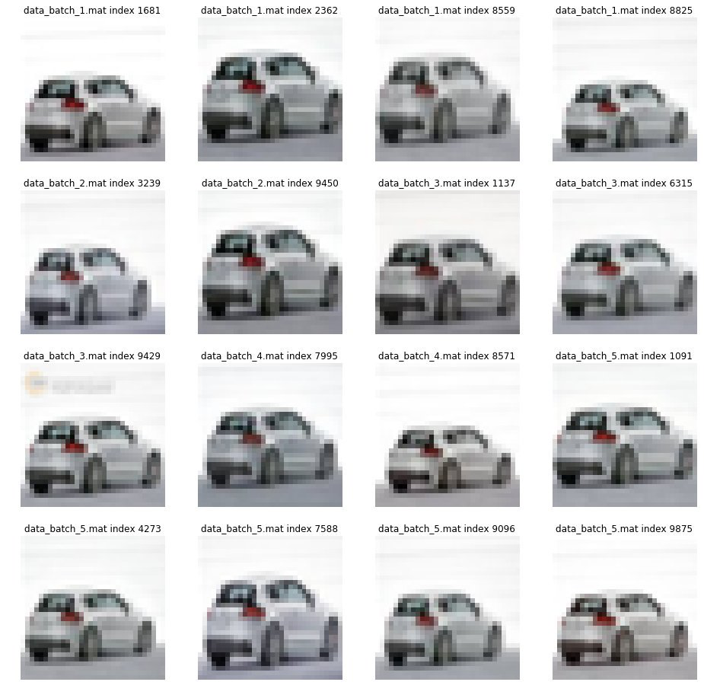
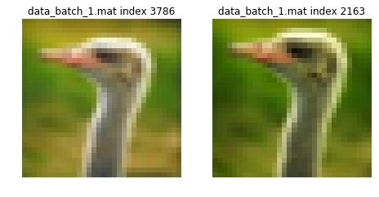
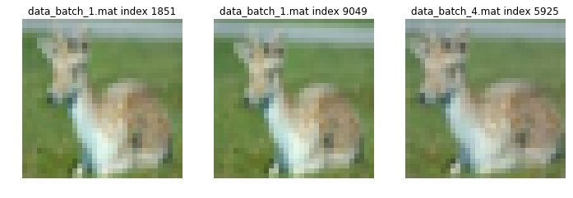
SelectiveBackprop
NOT ALL EXAMPLES ARE EQUALLY USEFUL

Slide 19
SelectiveBackprop
Which examples are challenging?

Slide 20
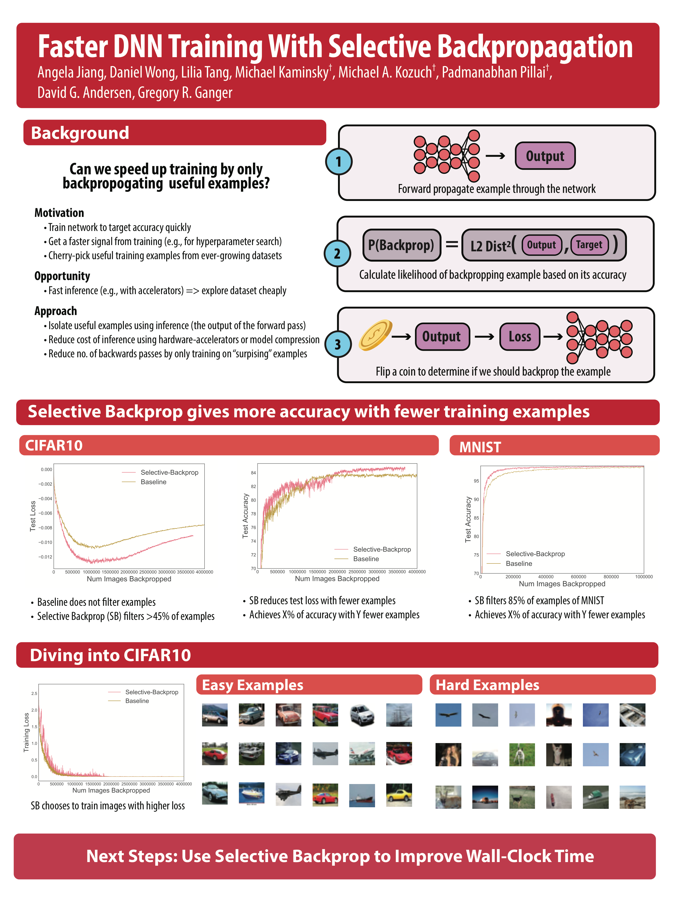
SelectiveBackprop
PRIORITIZE EXAMPLES WITH HIGH LOSS
Examples with low loss
Examples with high loss
Notes:
Be more explicit about the connection between surprisingness and probability that you select it
by the way we have experimental evidence that suggest this is right. You can come see me at the poster session

Slide 21
SelectiveBackprop
SELECTIVE-BACKPROP PRIORITIZES HIGH LOSS EXAMPLES

Slide 22
SelectiveBackprop
SELECTIVE-BACKPROP PRIORITIZES HIGH LOSS EXAMPLES

Slide 23
SelectiveBackprop
ATTEMPT #1: DECIDING WITH A HARD THRESHOLD
if loss > threshold: backprop()

Slide 24
SelectiveBackprop
ATTEMPT #1: DECIDING PROBABILISTICALLY WITH LOSS
P(backprop) = normalize(loss, 0, 1)

Slide 25
SelectiveBackprop
SB APPROACH: USE RELATIVE PROBABILISTIC CALCULATION
P(backprop) =
Percentile(loss, recent losses)

Slide 26
SelectiveBackprop
SB APPROACH: USE RELATIVE PROBABILISTIC CALCULATION
P(backprop) =
Percentile(loss, recent losses)^{B}
Lower ^{B} makes SB more selective
Notes:
clamp -> normalize
Maybe talk about the lower bound, we do revisit all the images probabilistically

Slide 27
SelectiveBackprop
SELECTIVE-BACKPROP APPROACH
Forward propagate
example to get loss
Calculate usefulness of
backpropping example
using its loss
Decide probabilistically
if we should backprop
Notes:
Be more explicit about the connection between surprisingness and probability that you select it
We come up with this probability so that images that we have the most to learn from are most likely to be backpropagated
Move this back a couple of slides.
"lets focus on this question of deciding what to backprop"
Next slide would then be stale
CARTOON OF THE INNER LOOP AND THE FILTER. Then be like these are the different kinds of filters that we tried
Flip a coin ->

Slide 28
SelectiveBackprop
STALE-SB REDUCES FORWARD PASSES
StaleSB is a variant of SelectiveBackprop
Forward propagate
example to get loss
every n epochs
Notes:
Be more explicit about the connection between surprisingness and probability that you select it
We come up with this probability so that images that we have the most to learn from are most likely to be backpropagated
Move this back a couple of slides.
"lets focus on this question of deciding what to backprop"
Next slide would then be stale
CARTOON OF THE INNER LOOP AND THE FILTER. Then be like these are the different kinds of filters that we tried
Flip a coin ->

Slide 29
Selective-Backprop
How is Selective-Backprop’s performance?

Slide 30
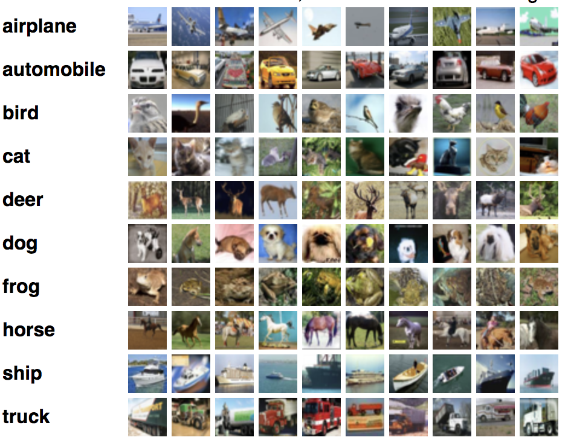
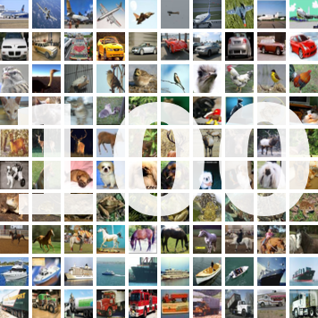
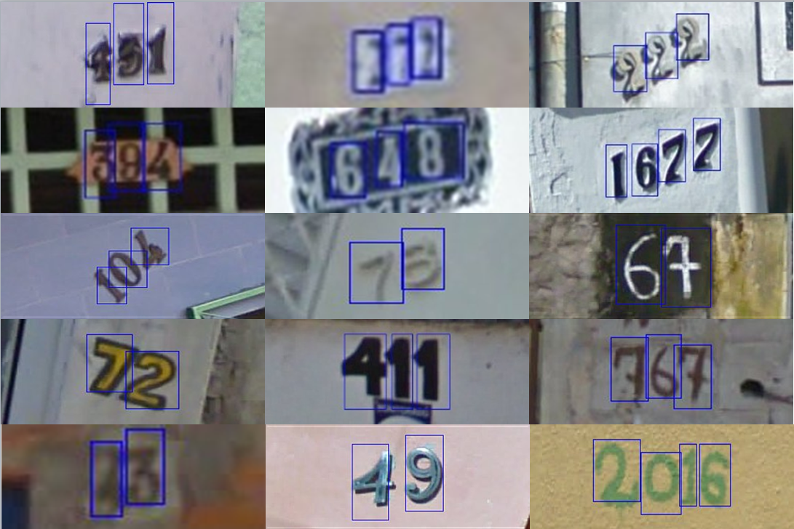
SelectiveBackprop
DATASETS
CIFAR10
CIFAR100
SVHN
60,000 Images
60,000 Images
604,388 Images

Slide 31
SelectiveBackprop
TRAINING CIFAR10 TO 4.14% (1.4X BEST FINAL ERROR)
SB: 1.5X faster
StaleSB: 2X faster
Notes:
SB: 1.5x
StaleSB: 2.0x
2.96%

Slide 32
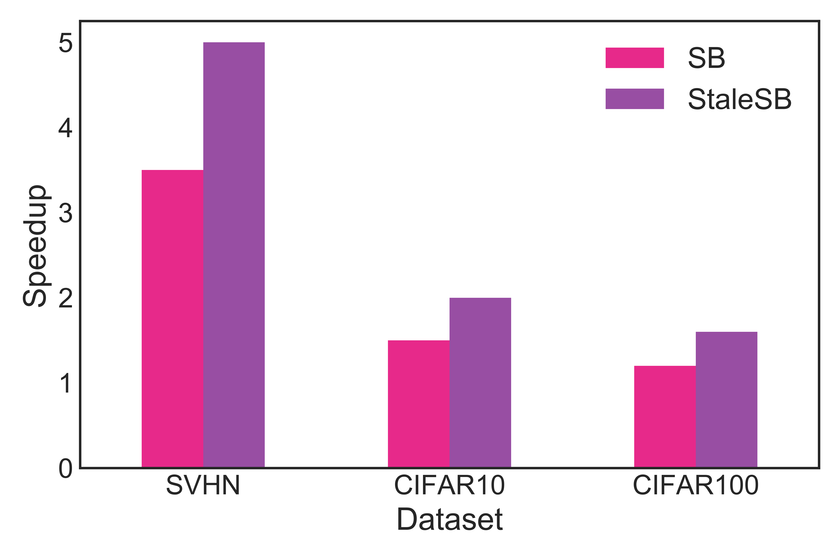
SelectiveBackprop
SB ACCELERATES BY 1.2-3.5X, STALESB ACCELERATES BY 1.6-5X
60,440
Examples / class
6,000
Examples / class
600
Examples / class
All backprops
Notes:
SB: 1.5x
StaleSB: 2.0x
2.96%
PUT A LINE ACROSS ONE THAT SAYS DOING

Slide 33
SelectiveBackprop
STALE-SB REDUCES FORWARD PASSES
Notes:
SB: 1.5x
StaleSB: 2.0x
2.96%

Slide 34
SelectiveBackprop
COMPARED APPROACHES
Traditional
Classic SGD with no filtering
Katharopoulos18
State of the art importance sampling approach
Random
Random sampling approach
Selective-Backprop (Us)
Notes:
In the real world, we don't know what accuracy we can get to, but we may have a fixed amout of time. Most of the time you'll do better this way. super optimized, run forever kind of things to get the best state of the art accuracy. A lot of times you don't know what the accuracy's gonna be. You're gonna care about it a little less
Remove this whole slide

Slide 35
SelectiveBackprop
SVHN
Given 40 hours to train,
Stale-SB provides lowest error
Notes:
CIFAR10: 72%
SVHN: 80%

Slide 36
SelectiveBackprop
MOST PARETO OPTIMAL POINTS ARE SB OR STALE-SB
Given unlimited time to train,
Traditional provides lowest error
Notes:
CIFAR10: 72%
SVHN: 80%

Slide 37
SelectiveBackprop
SELECTIVE-BACKPROP ON CIFAR10 TARGETS HARD EXAMPLES
= [0, 1, 0]
3% correct w/ Traditional
29% correct w/ SB
= [0.1, 0.3, 0.6]
= 0.3
Notes:
20th percentile of target confidences for SB is 55%
Put a vertical line here!
Make the graph larger and put labels on the line
put these before it's pareto
MAYBE CUT

Slide 38
SelectiveBackprop
SB IS ROBUST TO MODEST AMOUNTS OF LABEL ERROR
10% Randomized
Notes:
1.4048, 0.360544 = 74.3% fewer backward passes
55% more forwards passes
move the labels ahead
Next move: SelectiveAugment
The studff i was just taling about. imagein that you have a bunch of things that you do to imagines before you pass them trhough the n ewtork, for isntance rotating them and cropping

Slide 39
SelectiveBackprop
SB IS ROBUST TO MODEST AMOUNTS OF LABEL ERROR
20% Randomized
Notes:
1.4048, 0.360544 = 74.3% fewer backward passes
55% more forwards passes
move the labels ahead
Next move: SelectiveAugment
The studff i was just taling about. imagein that you have a bunch of things that you do to imagines before you pass them trhough the n ewtork, for isntance rotating them and cropping

Slide 40
AdaptSB
Should we prioritize challenging examples?

Slide 41
AdaptSB
ADAPT PRIORITIZATION TO DATASET AND TRAINING TIME
Probability
Percentile

Slide 42
AdaptSB
ADAPT PRIORITIZATION TO DATASET AND TRAINING TIME
Probability
Percentile

Slide 43
AdaptSB
DETERMINE PRIORITY FUNCTION USING HP SEARCH
Probability
Percentile

Slide 44
AdaptSB
ADAPT PRIORITIZATION TO DATASET
CIFAR10
0% Randomized
10% Randomized
20% Randomized

Slide 45
AdaptSB
ADAPT PRIORITIZATION TO DATASET AND TRAINING TIME

Slide 46
AdaptSB
ADAPT PRIORITIZATION TO DATASET
NoFilter
Test error rate
Fraction of test labels shuffled

Slide 47
AdaptSB
ADAPT PRIORITIZATION TO DATASET
NoFilter
SB
Test error rate
Fraction of test labels shuffled

Slide 48
AdaptSB
ADAPT PRIORITIZATION TO DATASET
NoFilter
SB
AdaptSB
Test error rate
Fraction of test labels shuffled

Slide 49
AdaptSB
ADAPT PRIORITIZATION TO TRAINING TIME
After 30 epochs
After 70 epochs
After 160 epochs
In CIFAR10, challenging examples are increasingly useful

Slide 50
AdaptSB
ADAPT PRIORITIZATION TO TRAINING TIME
After 30 epochs
After 70 epochs
After 160 epochs
Prioritize different examples at different times

Slide 51
AdaptSB
ADAPT PRIORITIZATION TO DATASET AND TRAINING TIME
NoFilter
SB
AdaptSB
AdaptSB over time
Test error rate
Fraction of test labels shuffled

Slide 52
SelectiveBackprop
TAKEAWAYS
✓
SB adapts to which examples are challenging
Trains up to 3.5x faster than standard SGD by prioritizing them
✓
StaleSB further accelerates training
Trains on average 26% faster compared to SB
✓
AdaptSB adapts prioritization to dataset and time
More robust than SB on datasets with label error
www.github.com/angelajiang/SelectiveBackprop

Slide 53
SelectiveBackprop
TAKEAWAYS
✓
SelectiveBackprop accelerates training
Reduces time spent in the backwards pass by prioritizing high-loss examples
✓
SelectiveBackprop outperforms static approaches
Trains up to 3.5x faster compared to standard SGD
✓
Stale-SB further accelerates training
Trains on average 26% faster compared to SB
✓
OptimSB tailors SB to the dataset and training time
Trains on average 26% faster compared to SB
www.github.com/angelajiang/SelectiveBackprop
Notes:
1.4048, 0.360544 = 74.3% fewer backward passes
55% more forwards passes
move the labels ahead
Next move: SelectiveAugment
The studff i was just taling about. imagein that you have a bunch of things that you do to imagines before you pass them trhough the n ewtork, for isntance rotating them and cropping

Slide 54
Introduction
CASE STUDIES
SelectiveBackprop
Adaptive Sampling for DNN Training
Mainstream
Adaptive Stem-Sharing for DNN Inference

Slide 55
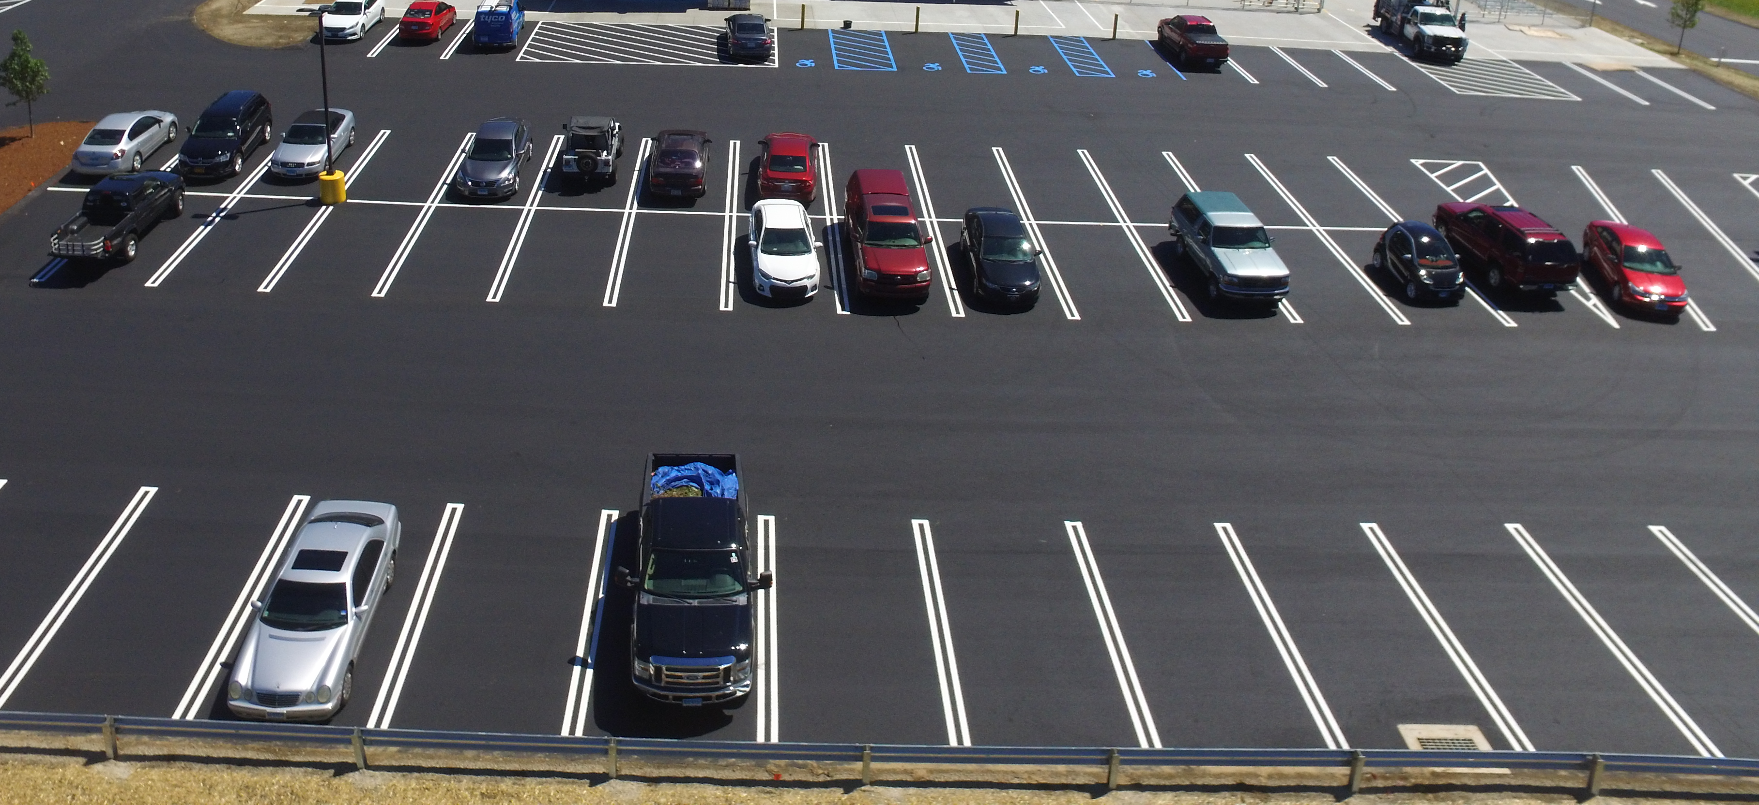
parking violation monitor
parking spot finder
fender-bender monitor
white
Camry
detector
Notes:
Mainstream is a system for automatically training and deploying concurrent video analysis applications. So i’ll start off by giving an example where mainstream can be of some help.
So imagine you have a camera, generating a video stream that’s Analyzing the stream in real time. So you can imagine that there are a lot of ways that you want to use this video feed. Fr instance the mall itself might want to see a parking violation monitor. bBt there might also be other third-party vendors the one independently develop applications as well. So a startup might want to create a parking spot finder app. Insurance companies might want to monitor for fender benders. Maybe the police that day are looking for a particular white Camry and they want to know if it's in this parking lot. So advances in machine learning and in particular DNNs have allowed applications like these to arise. But to enable a multi-tenant deployment like this still brings about a lot of systems and infrastructure challenges. That's what mainstream is focused on and that's what I'll be talkin about today.

Slide 56
Introduction
CHALLENGES AND CONTRIBUTIONS
Shares video stream processing of concurrent apps
✓
By sharing redundant computation
Adaptively tunes degree of specialization at runtime
✓
Based on resources available and deployed apps
Notes:
Mainstream addresses two main challenges, The first one is that time sharing these concurrent DNN makes inference really slow. While you may be able to run a single DNN on your Edge device in real time, as you add more applications, the DNNs are going to start contending for resources and you're ultimately going to start dropping frames. Instead, in mainstrea, we’re going to find computation that's redundant between the applications and then share that computation, thus reducing resource contention and allowing you to process at a faster frame rate. Now this turns out to be a very important optimization to do if you want your deployment to scale. But in order to actually optimize for this, we have to collaborate between applications. That brings us to our Second Challenge, which is that these DNNs are typically tuned in isolation from each other and at development time. This is fundamentally the wrong time to be performing this optimization, because at development time you're not going to know what resources you're going to run on and you certainly shouldn't be expected to know what other applications are going to be running alongside of you. In mainstream, we optimize for DNN computation sharing and we do this at runtime where we can adapt to the resources available and what applications are running.
These are the two main techniques that'll talk about today. For one, I’ll talk about where does this opportunity for sharing come from. And then I’ll talk about how we optimize for DNN sharing and how we defer that decision to runtime. Ultimately, I'll show how Mainstream performs against some default static approaches. I’ll start with the first one.

Slide 57
Mainstream
EXAMPLE VIDEO ANALYSIS PIPELINE
Decode
Transform
Classify
Post-process
Edge Node
Notes:
To make this more concrete, I'll first start with an example video analysis pipeline. To start with, we have a camera generating frames, for instance at 30 frames per second. Each frame is going to be processed on the edge device through a series of computations. First the frame will be decoded from h.264. We’ll then transform it in some ways -- maybe we'll crop it, maybe will normalize it. And then will actually perform the analysis step. In mainstream we focus on image classification and that's performed using a DNN. Then the output of the DNN will be post-processed in some way.

Slide 58
Mainstream
DNN IS THE PRIMARY COST OF THE PIPELINE
Classify (DNN)
Notes:
Another important thing to note about this pipeline is that the DNN is the primary cost of the pipeline. And not only is it very computationally expensive, but when you add more applications to your deployment. it's very easy to share the initial pre-processing steps for each frame, but the DNN is task specific. So this isn't a very scalable appproach to deploying multiple DNN. And I should say that in mainstream we're not focused on reducing the latency of a single DNN, but making adding applications more scalable. In mainstream, instead we're going to share a large portion of the DNN, and then publish those outputs to smaller task specific DNNS. This is essentially a faster way to run the same 3 DNNs that I showed before. And now if you wanted to add a fourth application, you would just need to add a small task specific DNN to the end and so it's very low marginal cost.

Slide 59
Mainstream
DNN IS THE PRIMARY COST OF THE PIPELINE
Classify (DNN)
Classify (DNN)
Classify (DNN)
Notes:
Another important thing to note about this pipeline is that the DNN is the primary cost of the pipeline. And not only is it very computationally expensive, but when you add more applications to your deployment. it's very easy to share the initial pre-processing steps for each frame, but the DNN is task specific. So this isn't a very scalable appproach to deploying multiple DNN. And I should say that in mainstream we're not focused on reducing the latency of a single DNN, but making adding applications more scalable.

Slide 60
Mainstream
IN MAINSTREAM: PARTIAL SHARING OF DNNS
Efficiently run same 3 DNNs
Notes:
In mainstream, instead we're going to share a large portion of the DNN, and then publish those outputs to smaller task specific DNNS. This is essentially a faster way to run the same 3 DNNs that I showed before. And now if you wanted to add a fourth application, you would just need to add a small task specific DNN to the end and so it's very low marginal cost.

Slide 61
Mainstream
How do we find redundancy between DNNs?

Slide 62
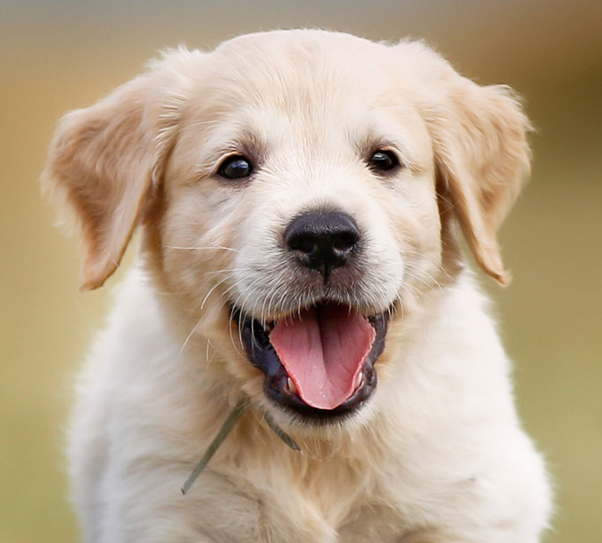
Mainstream
FINE-TUNING DNN #1
Notes:
Now the question becomes how do we actually find that shared stem, how do we find redundancy between DNNs. To do this, we take advantage of how people train their DNNs. People train their DNNS using something called transfer learning, which I’ll explain next
This is an example DNN. During training time you take weights that are randomized and then you'll feed it a bunch of labeled examples where you know what the answer should be, and slowly move the weights for the state where you get a good result. But this isn't how most people actually train their DNNs, because to train weights from scratch takes a lot of computational resources and also a lot of data which most people don't have for their task. So instead what you do is something called transfer learning where you take a DNN that was already trained for an old task and then fine-tune it for your new task. Here is an old pre-trained network, we take off the old task specific layer, add our new task specific layer, and then when we train we hold a subset of the layers Frozen so that those weights don't change and then we finetune our tasks specific layer. Even though this is the default approach, you don't necessarily have to only fine-tune the last layer. In this case, we’ve held three layers frozen and fine-tuned two.

Slide 63
Mainstream
FINE-TUNING DNN #2
Notes:
DNN/transfer learning background

Slide 64
Mainstream
TWO DNNS AS RUN IN MAINSTREAM
Notes:
So the important thing for Mainstream here is, if you have two networks that were pre-trained off the same base DNN, whatever layers that were held Frozen during training time will be identical, and that’s where you get the redundance from. We actually expect this to happen pretty organically because there's only a handful of Industry standard DNN architectures and an even smaller handful of datasets used to pre train them.
In mainstream we’ll provide the coordination and remember that those layers are identical at run time. When we perform inference every frame is an only run to the shared stem once. Those outputs will be published to task-specific layers and we’ll get the output.

Slide 65
Mainstream
How do we decide what to finetune?
Notes:
That's where the opportunity for sharing comes from and how you take advantage of it. But the question is, how do we actually optimize what amount of sharing we want and what amount of specialization we want. Right now what happens is that is independently determined for each application and it's determined at development time so the application developer when training their task is going to determine how many layers they want to specialize which then dictates how much were allowed to share at runtime. Instead, what we want to do is we want to optimize for this dependent on the resources available and what applications are deployed. This is really the Crux of the Mainstream case study, so next we'll talk about how we perform the DNN sharing and how we defer that optimization at run time, so we can adapt to the resources available and the set of apps.
To optimize for DNN sharing, we first have to understand the trade-offs that come from sharing and specialization, and that's what I'll talk about next.

Slide 66
Mainstream
More sharing =
Higher throughput
More specialization =
Higher per-frame accuracy
Notes:
Here I have two ends of the spectrum, on the left we are sharing as much as possible and only specializing the last layer and on the right we're not sharing anything. On the left we have less computation, there’s less contention and so we're going to get a higher throughput. Whereas on the right during training time we specialize the entire network for a task, which means that our model is going to have the best accuracy possible. The question really becomes, do you want to analyze your video stream at a higher frame rate or do you want to analyze every frame more accurately.
We make that decision based on how those two metrics affect your final application performance. So we’ll talk about how we actually measure application performance.

Slide 67
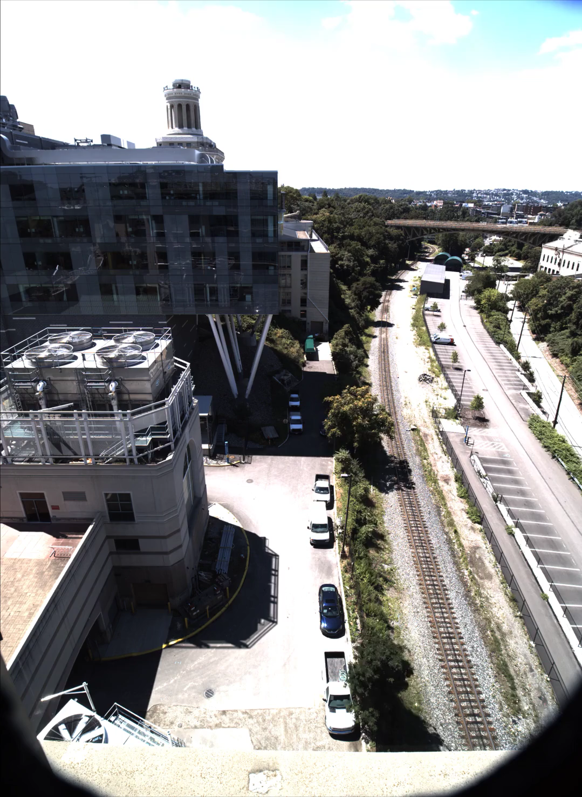
Application example:
Event detection
Notes:
In the paper, we focus mostly on the case study of event detection. This is an example application of performing event detection. This is a video stream from the train tracks next to CMU. An example application is that we want to monitor for environmental pollution from the train which means our app needs to detect every time the front of the train comes by.

Slide 68
Mainstream
HOW DO WE DECIDE WHAT TO FINE-TUNE?
Event Recall How many relevant events are detected?
Event Precision How many detected events are relevant?
Event F1 Score Harmonic mean between precision and recall
Notes:
The three metrics that we're going to use to measure the performance of this application are 3 common machine learning metrics. First we’ll measure the event recall which is what percentage of the events are actually detected; The precision which is out of the things that we said were trains how many were actually trains; and F1 score which is the harmonic mean between precision and recall.
The next thing we need to understand is how the model accuracy and your throughput affects your applications F1 score.

Slide 69
Mainstream
HOW DO WE DECIDE WHAT TO FINE-TUNE?
BEST CONFIGURATION DEPENDS ON ACCURACY AND FPS
Event Recall How many relevant events are detected?
Event Precision How many detected events are relevant?
Event F1 Score Harmonic mean between precision and recall
Notes:
And you don’t know if that there’s similarities between with them. Did all of the red stuff twice. Base piece of our opportuniy. REd stuff doesn’t have to be done twicwe
Because the output of the red stuff is gonna be identical. Animate in merged DNNed. Number of bubbles you have to process are smaller, and if you have milions of bubbldes but hundreds of thousands of red bubbles

Slide 70
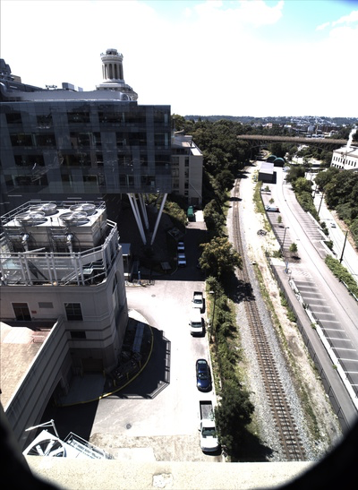
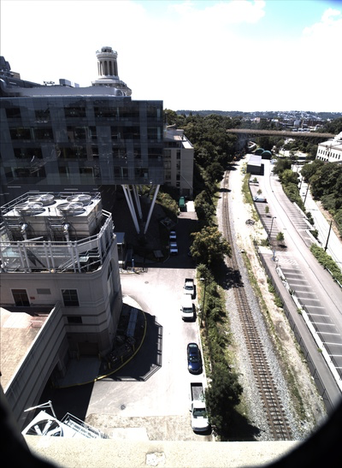
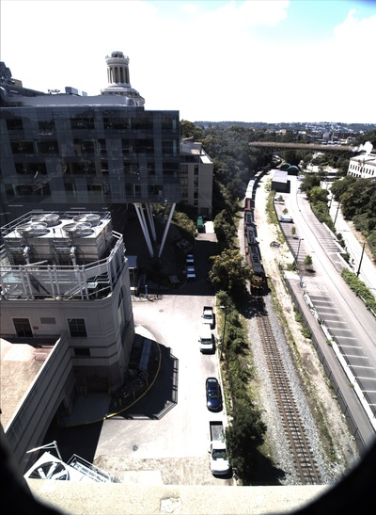
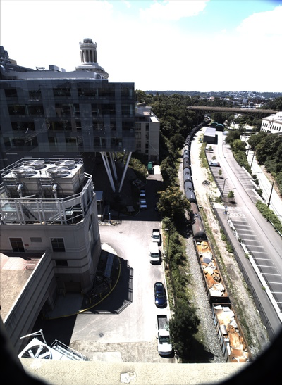
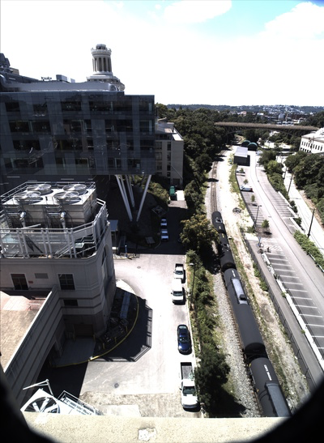
Notes:
Grey out
Hammer on *front* of the train, so needs to be one of the two

Slide 71
Goal: Classify frame with front of train
Notes:
Grey out
Hammer on *front* of the train, so needs to be one of the two

Slide 72
Low FPS can lead to missing event
Notes:
Grey out
Hammer on *front* of the train, so needs to be one of the two

Slide 73
Low FPS can lead to missing event
Notes:
Grey out
Hammer on *front* of the train, so needs to be one of the two

Slide 74
High FPS gives model MORE opportunities
Notes:
Grey out
Hammer on *front* of the train, so needs to be one of the two

Slide 75
Selective-Backprop
How does sharing potential affectt accuracy and thoughput?

Slide 76
Analytical model estimates
marginal benefit to f1-score
Given an increase in
accuracy or throughput
Depends on runtime conditions

Slide 77
Mainstream
SYSTEM ARCHITECTURE
Notes:
Next I’ll talk about what mainstream actually is, by going through the architecture. Mainstream consists of three components: the trainer the scheduler and the runner.

Slide 78
Mainstream
SYSTEM ARCHITECTURE
Run offline by user
Notes:
From a user's perspective what I'm going to do to run mainstream is I will take my labeled data set and train it with M Trainer. Importantly this can still be done with full control of my data, I don't have to centralize my data anywhere and I can train my network whenever I want.

Slide 79
Mainstream
SYSTEM ARCHITECTURE
Run on cluster
across applications
Notes:
Once I'm ready to deploy my application, I'm going to send the output of M Train to M scheduler. M scheduler is run globally across all deployed applications and its run on the cluster. And for every deployed application, it's going to determine how much of the network to specialize and how much of the network to share.

Slide 80
Mainstream
SYSTEM ARCHITECTURE
Run analysis on edge node
Notes:
Those results are then going to be sent to M Runner. This is the module that's actually running on the edge device and performing the video analysis. The outputs of M-Runner are then going to be returned to the user.

Slide 81
Mainstream
SYSTEM ARCHITECTURE
Outputs multiple models
Notes:
Today I'm going to focus on talking about M trainer because this is what allows us to defer that optimization to runtime. Like I said I'm trainer takes a labeled dataset. While a typical trainer would use that to train a model, what M-trainer does it takes the label data set and trains multiple models that perform that task. The difference between each of the models is how much of the network we held frozen during training time. Then we store the model themselves as well as some metadata about the models, including the estimated accuracy and some information about the dataset itself. What this allows us to do is that if at run time we decide that we want to share 80% of the network, then we can just go back and we can take the model that had 80% of the network's frozen during training time.

Slide 82
Mainstream
EXPERIMENTAL SETUP
Run concurrent image classification pipelines (MobileNet-224)
Events Pedestrian, bus, red car, all-cross, school bus, train, car
Hardware Desktop-class Intel i7
Video stream 20 FPS, 224x224 pixels
Decode
Transform
Classify
Post-process
Notes:
Now I'll talk about how mainstream performs against some default static approaches. What we're going to do here is we're going to run concurrent image classification pipelines like the ones I showed earlier.The pipelines are going to detecting one of seven events so they're going to detect if there is a pedestrian in scene, a bus in the scene, a red car, etc.

Slide 83
Mainstream
Max Sharing
No Sharing
Notes:
The two static approaches that we’ll compare against is max sharing and no sharing, both of which are common default approaches.

Slide 84
Mainstream
MAINSTREAM OUTPERFORMS STATIC METHODS
Notes:
On the X-axis, we're increasing the number of concurrent applications up to 25. And on the y-axis we're showing the average event F1 score across the applications and higher is better. In the red we have mainstream, in the Blue, Max sharing and in the green, no sharing.

Slide 85
Mainstream
MAINSTREAM OUTPERFORMS STATIC METHODS
Frame relative
accuracy: 1
0.36 FPS
Notes:
No sharing has the benefit of never having to sacrifice model accuracy. But as you add applications, the throughput degrades really quickly and you start missing frames.

Slide 86
Mainstream
MAINSTREAM OUTPERFORMS STATIC METHODS
Frame relative
accuracy: 0.59
6.8 FPS
Notes:
With max sharing, we have the opposite problem. It's a very scalable approach and we’re able to retain a very high throughput even with a large number of applications. But we held so much of the network Frozen during training time that the models aren't very good.

Slide 87
Mainstream
MAINSTREAM OUTPERFORMS STATIC METHODS
Frame relative
accuracy: 0.59
6.8 FPS
Notes:
With max sharing, we have the opposite problem. It's a very scalable approach and we’re able to retain a very high throughput even with a large number of applications. But we held so much of the network Frozen during training time that the models aren't very good.

Slide 88
Mainstream
MAINSTREAM OUTPERFORMS STATIC METHODS
Frame relative
accuracy: 0.96
5.9 FPS
Notes:
Mainstream is a mix of both so sometimes it just decides to sacrifice a little bit of accuracy; sometimes it sacrifices a little bit of throughput, always in a way that maximally utilizes resources. An important takeaway of the results is that mainstream in almost all cases will greatly outperform a static approach. Compared to these two static approaches, there's two scenarios where it will perform the same. If you have one application, Mainstream will perform the same as no sharing. And if you have a very large amount of applications where your resources are saturated, Mainstream will perform the same as Max sharing. In between is where we have the benefit of performing the optimization.

Slide 89
Mainstream
MAINSTREAM OUTPERFORMS STATIC METHODS
Frame relative
accuracy: 0.9
5.6 FPS
Notes:
Mainstream is a mix of both so sometimes it just decides to sacrifice a little bit of accuracy; sometimes it sacrifices a little bit of throughput, always in a way that maximally utilizes resources. An important takeaway of the results is that mainstream in almost all cases will greatly outperform a static approach. Compared to these two static approaches, there's two scenarios where it will perform the same. If you have one application, Mainstream will perform the same as no sharing. And if you have a very large amount of applications where your resources are saturated, Mainstream will perform the same as Max sharing. In between is where we have the benefit of performing the optimization.

Slide 90
Mainstream
TAKEAWAYS
Adaptively tunes degree of specialization at runtime
✓
based on resources available and deployed apps
Mainstream outperforms default static approaches
✓
Up to 87x improvement in F1 score compared to no sharing
Up to 47% improvement compared to max sharing
www.github.com/angelajiang/mainstream
Notes:
In conclusion, I talked about how mainstream is able to provide a scalable multi-tenant deployment of concurrent video analysis applications. We do this by optimizing for DNN computation sharing and we defer this optimization to runtime so that we can adapt to the resources available and the set of deployed applications. As a result we see that mainstream greatly outperforms default static approaches while never performing worse.

Slide 91
Introduction
CONCLUSION
Using runtime information to dynamically adapt hyperparameters that are traditionally static, such as emphasis on individual training examples and the weights updated during transfer learning, can increase the accuracy and speed of ML training and inference.
Thank you!

